Slide 1

Power BI Dashboard In A Day Labs

Slide 2
Lab One - Dataset
Start Power BI Desktop. Save this empty report file to C:\DIAD, as “<Your Initials> Lab.pbix” (i.e. “KH Lab.pbix”)
Using Get Data, one at a time, add the following CSV files (located in C:\DIAD\Data) to your pbix; Location, Manufacturer, Product, Sales CA, Sales DE, Sales FR, Sales MX, Sales US
When adding the Location CSV, in the preview dialog box, click Edit, click Use First Row As Headers, then Save / Apply / Close the Power Query window
In Power BI Desktop, click Edit Queries / Edit Queries, to open Power Query
In the left side Queries pane, select the Sales US query, and rename the Sales field as Revenue, and at a custom column Country with a fixed value of United States
In the left side Queries pane, select Sales CA. In the ribbon, select Append Queries (drop down) / Append Queries As New. Create a new Query called Sales, combining the five Sales * queries together.
Select the Location query. In the ribbon, select Remove Rows / Remove Duplicates
Select the Location query. Select the Add Column ribbon. In the grid, click the State column header, hold your CTRL key, then select the Country column header. In the Add Column ribbon, select Merge Columns. Use a custom “, “ separator. Name the new column “State Country”.
Save / Apply / Close the Power Query window, to return to Power BI Desktop.
In Power BI Desktop, in the Model blade, create / delete joins, and hide tables from report view, to achieve the table join target state (see next slide). Also hide the Product.Manufacturer field from report view (as it’s already available in the Manufacturer table.

Slide 3
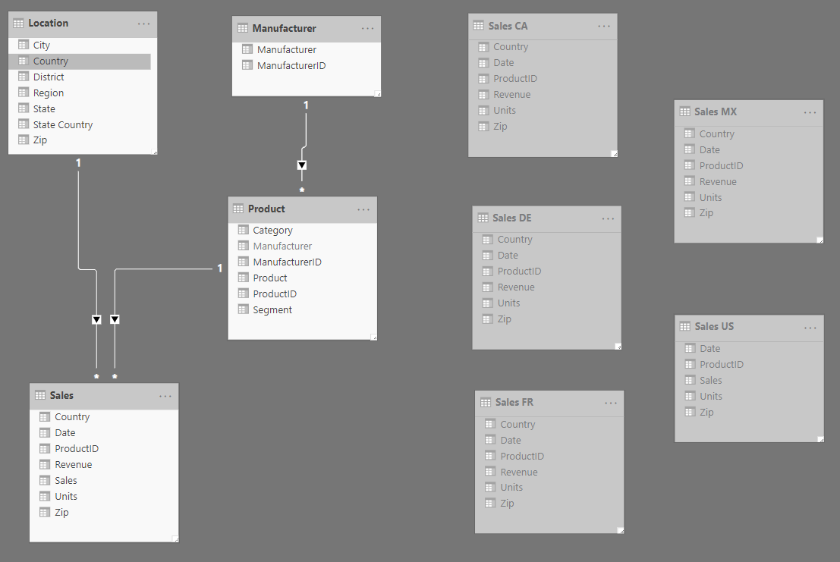
Lab One - Dataset
After implementing the above joins, in Power BI Desktop, go to the Data blade, and browse the different table data
In the Location table, select the State Country field, select the Modeling ribbon, and change the data category to “State or Province”
In the Sales table, select the Date field, select the Modeling ribbon, and set the date format to “yyyy-MM-dd”
In the Fields pane, confirm Power BI automatically created a Date Hierarchy under the Date field

Slide 4
Lab Two - Report
In C:\DIAD, open the “Adastra Power BI DIAD.pbix”, and refer to this report during the lab to guide report development
Open “<Your Initials> Lab.pbix”, and select the Report blade. Verify you see Location, Manufacturer, Product, and Sales tables in the right side Fields pane.
Rename Page 1 as “Sales Summary”
In the Fields list, click the ellipsis beside the Sales table, and select new measure. Create the below calculated measure:
Country Header * = IF(HASONEVALUE(Sales[Country]), "Sales For " & VALUES(Sales[Country]), "Sales for All Countries")
Create a report level filter, on the Sales.Date field, filtering for dates >= 2011-01-01
Add the Adastra logo and header border to the report page. Add the Country, Manufacturer, Segment, and Product fields as slicers in the header area. For the title in the header area, add a Card visual, using the Country Header * field in the visual.
Add a Date slicer in the top left of the report page, below the report header.
Add three card visuals below the date slider; Use the Format blade, to get the formatting right for the first visual. Use copy / paste to create a second card visual from the first card visual, replacing the visual’s data field. Do the same for the third card visual.
Implement remaining chart visuals on the report page, using the reference pbix as your guide.
Create a new report page called Sales Detail. Copy and paste relevant header / page elements from the Sales Summary page, to reproduce the common elements. Add the map / grid visuals to the page. Add Sales.Country as a drill through field.

Slide 5
Lab Three – Service
In Power BI Desktop, if not already signed in, login to the Power BI Service with your company account.
In Power BI Desktop, publish your lab pbix to My Workspace.
Using your browser, go to app.powerbi.com, and login with your company ID
Navigate to My Workspace, and open your published lab report.
Perform the following actions:
Export the report to PDF
Edit the report through your browser
Download a pbix copy, to update your local pbix with the updated version in the service
Slice for Canada, and create a personal bookmark “Canada”. Slice for US, and create a personal bookmark “US”.
Subscribe to the report
Slice for France. Pin multiple visuals to a new dashboard called “France Performance”. Go to the France Performance dashboard:
Arrange tiles to improve the dashboard layout
Switch to phone view, and arrange tiles for phone portrait mode
Switch back to web view
Add a comment to one of the visuals
If you pinned a card visual, create an alert to be notified when the card value crosses a threshold
Ask the following question: “top 5 revenue by product”
If you have an iOS / Android mobile device, install the Power BI Mobile app from the device’s app store, login to Power BI with your company account, and browse the report / dashboard you created

Slide 6

Thank you!

